Slide 1

Pitch Deck
"Streaming Secrets Unveiled: A Deep Dive into Netflix's Tittles Data Landscape" :
"Uncovering Hidden Trends and Insights Using MySQL and Power BI"
Suleiman Umar Farouk

Slide 2
Problem Statement
In my exploration of Netflix's vast data landscape, I encountered significant challenges due to missing information in key columns. Specifically, the Directors, Cast, and Country fields each had a substantial portion of their data absent:
Directors column: 39 missing entries.
Cast column: 11 missing entries.
Country column: 41 missing entries.
These gaps represent over 5% of the data for each respective column, making traditional imputation methods like mean or standard deviation inappropriate and potentially misleading.
This incomplete data hinders comprehensive analysis in several critical ways:
Reduced Analytical Scope: The absence of data in these columns limited my ability to explore and derive insights related to the creative and geographical aspects of Netflix's content. This restriction forced the exclusion of these dimensions from the project, potentially omitting valuable patterns and trends.
Skewed Insights: Missing data introduces bias, affecting the accuracy and reliability of any conclusions drawn. For instance, understanding the influence of directors or the diversity of content across countries becomes problematic when significant data is missing.
Decision-Making Challenges: Inaccurate or incomplete data can lead to flawed business decisions. For streaming platforms like Netflix, understanding the complete picture of content production and viewership is crucial for strategy and growth.
Recognizing the need for accurate and complete data to derive meaningful insights, my project focuses on navigating these challenges by:
Highlighting Data Gaps: Drawing attention to the areas where data is lacking to underscore the importance of robust data collection and maintenance.
Alternative Analyses: Concentrating on other data dimensions with complete information to uncover insights that are not compromised by missing entries.
.

Slide 3

Interesting Facts About The Data
Delving into Netflix's data unveils a fascinating journey from 1975 to 2021, encapsulating a vibrant history of the streaming giant’s offerings. Notably, the peak of content release was in 2021, a year that saw the highest number of new additions. This surge is especially intriguing when contrasted with the year 2020, which, despite being significant, saw fewer releases. This dip can likely be attributed to the global COVID-19 pandemic, which disrupted production schedules and altered media consumption patterns worldwide.
This period’s data provides a compelling narrative of how the streaming landscape adapted during unprecedented times. The resilience of the entertainment industry is evident in how Netflix managed to rebound in 2021, illustrating a robust recovery and a keen response to rising demand for home entertainment.
Additionally, the dataset’s variety in ratings offers a lens into Netflix's strategy to cater to a diverse audience base. The range of ratings, from family-friendly options to mature content, highlights Netflix's commitment to providing content for every demographic. Each rating category reflects the platform's extensive efforts to balance between catering to wide-ranging viewer preferences and adhering to content suitability standards across different regions.
In analyzing this data, we gain more than just numbers; we glimpse into the strategies, adaptations, and audience dynamics that define the modern streaming era. The story told through Netflix’s release years and ratings underscores the platform’s pivotal role in shaping contemporary entertainment and its relentless drive to meet and exceed audience expectations.
Value Proposition
Highlighting the value proposition and unique selling points of the solution is essential. This section focuses on conveying how the product stands out in the market and brings unparalleled benefits to the target audience.
The pitch introduces an innovative and transformative solution. It demonstrates how the product revolutionizes the traditional approaches and sets new benchmarks in addressing the identified problem.

Slide 4
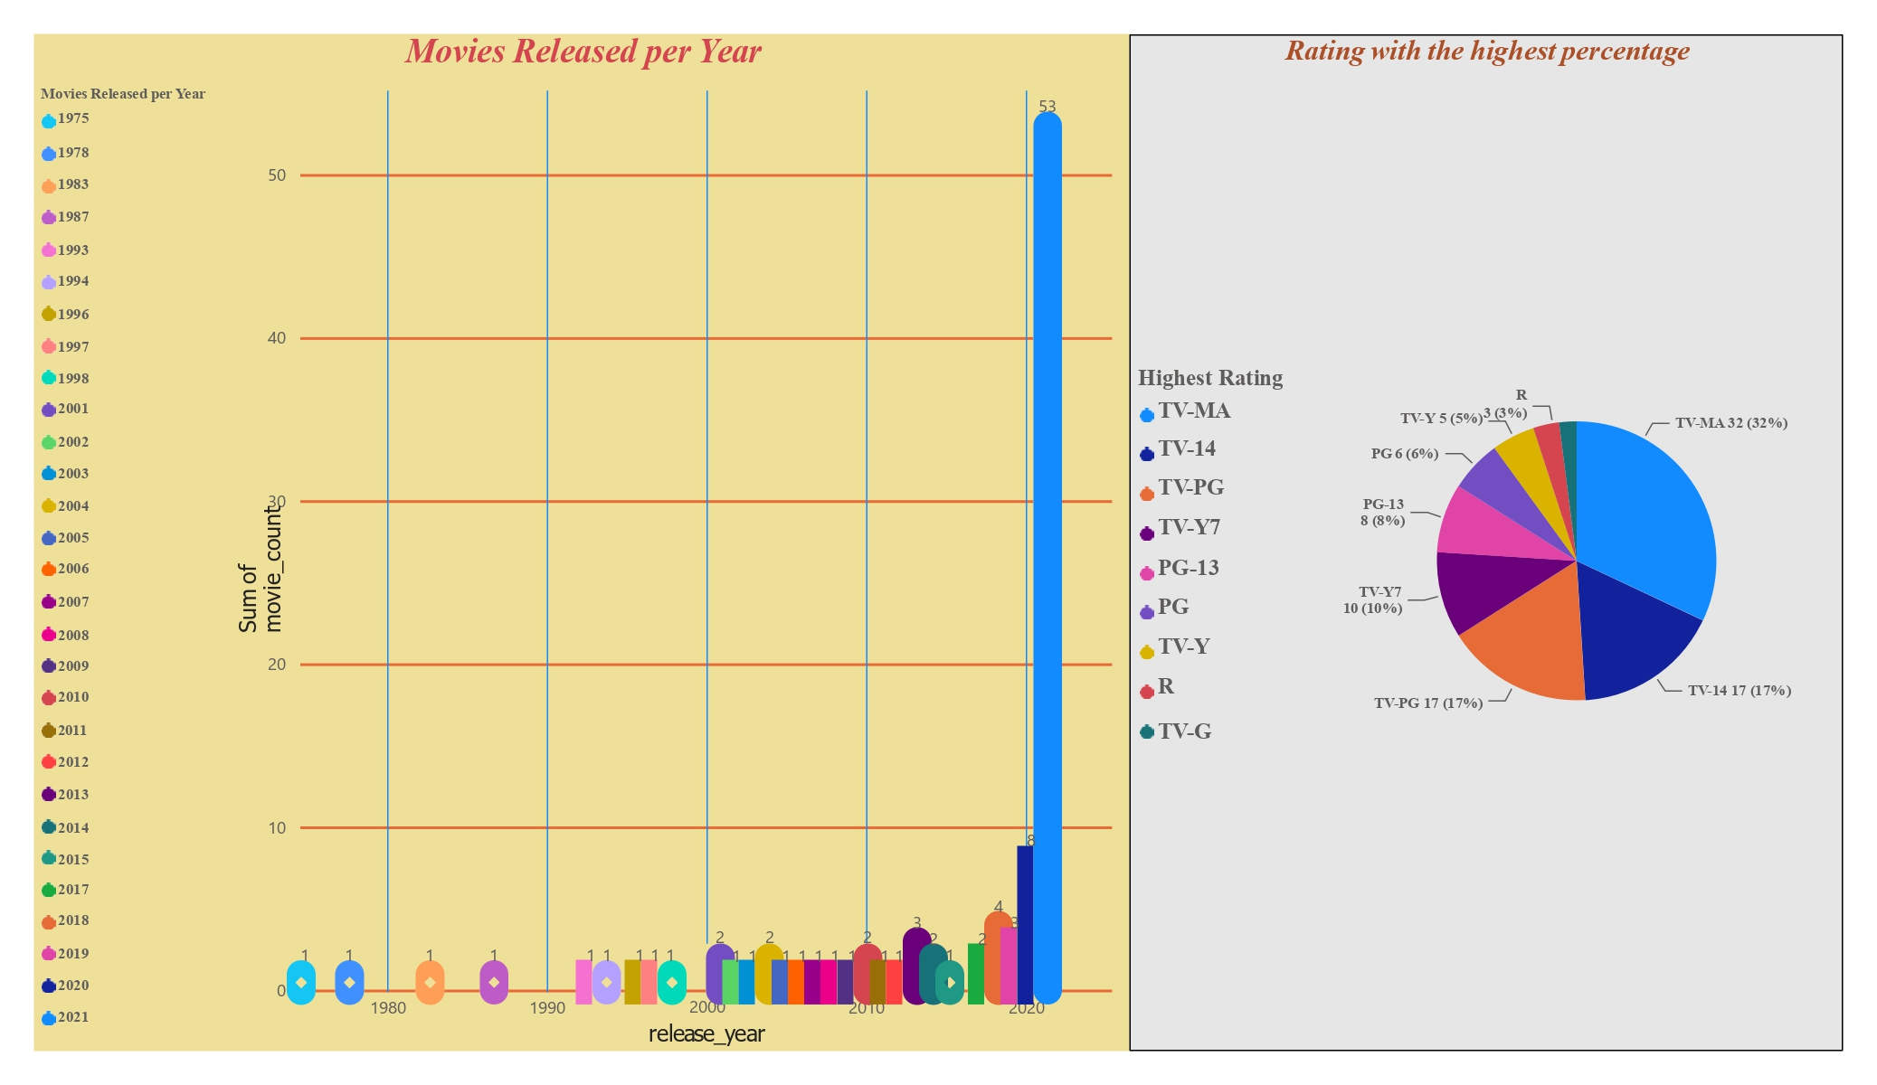
2 Cool Facts About The Data
.

Slide 5
2 Cool Facts About the Data cont.
During my analysis of Netflix's data, I discovered several compelling insights about its content distribution and ratings over the years:
1. Yearly Movie Releases: A Surge in 2021
The dataset reveals a significant surge in movie releases in 2021, with 53 out of 100 movies released that year alone. This peak likely reflects Netflix’s strategic push to expand its content library in response to increased demand for home entertainment during the COVID-19 pandemic. Conversely, 2020 saw only 8 releases, likely due to production disruptions caused by the pandemic. Interestingly, 2019 only had 3 releases, indicating a steady build-up leading to the 2021 surge.
2. Diverse Ratings: Catering to All Audiences
The data also highlights the diversity of content ratings on Netflix. The TV-MA rating is the most prevalent, accounting for 32% of the movies, showing a strong focus on mature content for adult audiences. Both TV-14 and TV-PG follow, each making up 17%, which reflects Netflix's effort to cater to both teenage and family viewers. This range of ratings demonstrates Netflix's commitment to offering a broad spectrum of content suitable for all age groups and preferences.
Conclusion
More data can be explored from the previous slide
Value Proposition
Highlighting the value proposition and unique selling points of the solution is essential. This section focuses on conveying how the product stands out in the market and brings unparalleled benefits to the target audience.
The pitch introduces an innovative and transformative solution. It demonstrates how the product revolutionizes the traditional approaches and sets new benchmarks in addressing the identified problem.

Slide 6
Questions asked about the Data
In my analysis of Netflix's data, I explored two pivotal questions to understand content suitability and release trends.
1. How Many Netflix Movies Require Parental Guidance?
To assess audience suitability, I categorized the movies into three groups:
- Parental Guidance Needed: Includes ratings like TV-PG, TV-14, and PG-13, PG, R, TV-MA, indicating content that may not be suitable for younger viewers without supervision.
- Suitable for All Audiences: Rated G or TV-G, these movies are appropriate for viewers of all ages.
- Children’s Content: Specifically aimed at young viewers, including TV-Y or TV-Y7 ratings.
This categorization helps illustrate how Netflix segments its content to cater to various audience needs. The dashboard on the next slide will highlight the distribution across these groups.
2. Nature of Movies Released in 2021
With 53% of the dataset’s movie releases occurring in 2021, I examined how these releases fit into the same audience suitability categories. This analysis reveals Netflix's content strategy during a peak release year, showing whether the majority were aimed at adults, families, or children.
Conclusion
These questions and their answers provide a nuanced view of Netflix’s approach to content distribution and audience targeting, particularly during the high-activity period of 2021. The following slides will present dashboards visualizing these insights.
.

Slide 7
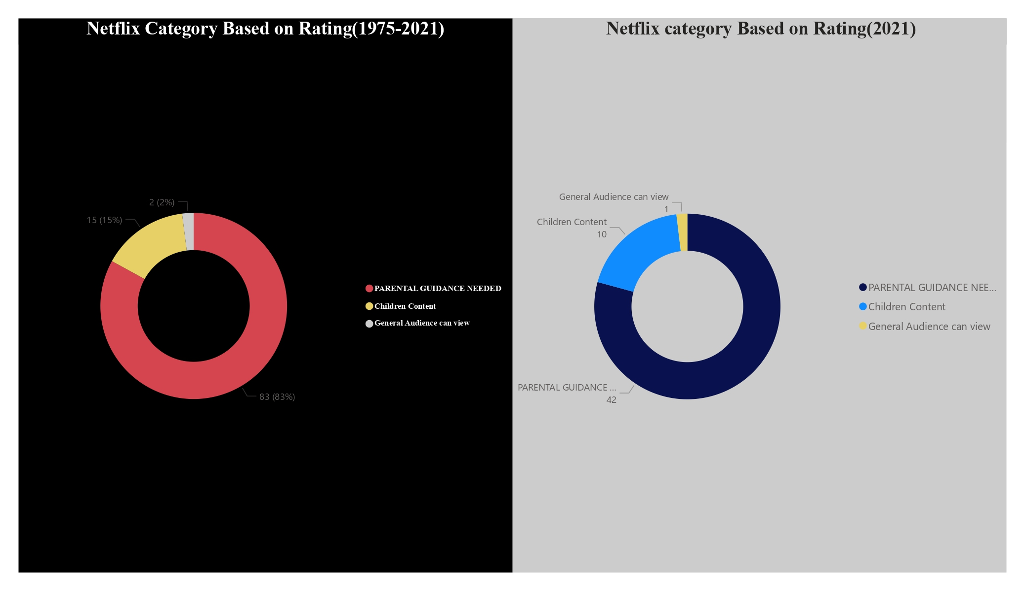
2 Questions About The Data
.

Slide 8

Final Thoughts
In my analysis of Netflix’s data from 1975 to 2021, I uncovered intriguing trends and challenges. Notably, 2021 saw a surge with 53% of movie releases, likely a rebound from the pandemic's impact in 2020. The data also revealed diverse ratings, with 32% TV-MA and significant family-friendly content. Despite these insights, missing data in key columns posed challenges, limiting full exploration. By categorizing movies into audience suitability groups, I highlighted Netflix's strategic content distribution. These findings underscore Netflix’s dynamic approach to content creation and its resilience in adapting to changing viewer demands and market conditions.
.

Slide 9

.

